Slide 1
Some learnings from recent Learnings from recent public procurement of prescription only (Rx) medicines (economic operator's perspective).
Miha Božič
Tendering & Pricing lead for the Balkan region
Belgrade, June 1st 2016

Slide 2
WHO WE ARE
We are known as MSD. We are known as Merck in the United States and Canada.
RICH HISTORY
Operating since 1851
- This year we celebrate 125 years of MSD since 1891
BUSINESSES
Pharmaceuticals, Vaccines, Biologics and Animal Health
Key Company Facts
2015 REVENUES
$39.5 billion; 66% of sales come from outside the United States
2015 R&D
EXPENSE
$6.6 billion; 20 products in late-stage development; key areas: oncology, CV, diabetes, respiratory & immunology, neurology, infectious disease and vaccines
EXTERNAL LICENSING
More than 100 significant licensing and partnership deals were completed in past years
HEADQUARTERS
Whitehouse Station, New Jersey, U.S.A.
EMPLOYEES
Approximately 68,000 worldwide (as of 12/30/15)
Notes:
2

Slide 3
Business Areas of Focus
Prescription Pharmaceuticals & Vaccines
Major Therapeutic Areas
Cardiovascular
Diabetes & Obesity
Infectious Disease
Neurosciences
Oncology
Respiratory & Immunology
Vaccine-preventable diseases
Women’s Health & Endocrine
Animal Health
Livestock
Poultry
Companion Animal
Aquaculture

Slide 4
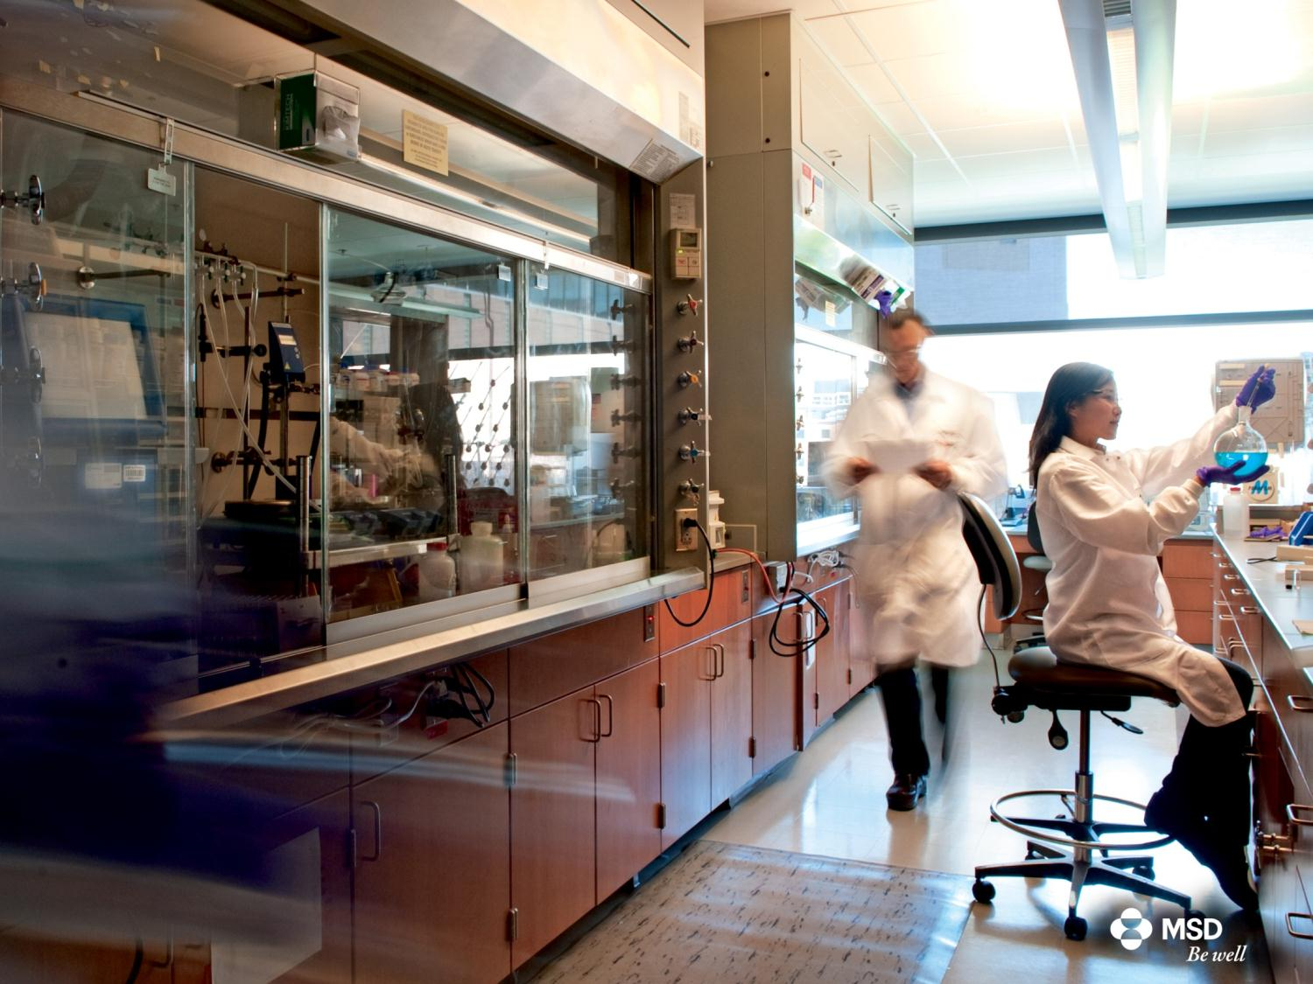
Our Mission
To discover, develop and provide innovative products and services that save and improve lives around the world.

Slide 5
Public market for pharmaceuticals
General Characteristics
Additional impact of public procurement
Complex, Expensive & Time consuming R&D
Strict and heavy market regulation
Marketing authorization (regular updates required)
Pricing regulation (IRP, TRP, regular updates)
Negotiations for public reimbursement
Very strict rules on promotion
Pharmacovigilance/Drug safety
Demanding production and supply environment
Highest standard of quality in manufacturing and supply
Robust advanced planning
Regional / Global impact of supply issues
Another layer of rules and principles that ultimately shape market conditions:
Type of pubic procurement process
Technical specifications
Contract award criteria
Contract duration
Joint national tender
Awarding of contracts to one candidate only
Typical public procurement of medicines in the Balkans:
Joint tender on national level
Open procedure, 1-4y contract duration
Generic name (INN) specification
Best price wins, contract awarded to one candidate per lot

Slide 6
Does tendering always makes sense?
Organizing a tender DOES NOT make sense where it is NOT reasonable to expect that multiple candidates will be able to meet the same tender requirements (technical specification)
Tenders for products that are dispensed directly to patients in pharmacies
WHY: medicines are prescribed to patients with Brand Name, not generic name. Pharmacy needs to have all brands available
SOLUTION: exclusion of medicines, intended for RESALE from public procurement (already implemented in CROATIA and BULGARIA)
Tenders for innovative patent protected medicines
WHY: patent protected medicines are often distributed through exclusive distribution channels.
SOLUTION: use of negotiated procedure w/o prior notification directly with distributor of each medicine

Slide 7
Does tendering always makes sense? Advantages of negotiated procedure vs. open procedure
 | Open procedure | Negotiated procedure
Ability to reach best possible solution for both contracting parties | Candidate can only adjust price | Price + innovative pricing solutions (pay for performance) other elements (free goods, price/volume discounts, additional services, favorable delivery conditions, solutions…)
Complexity | On size fits all approach, Delays in case of complaints for all medicines | Tailored approach, Low chance of complaints
Added value of procurement procedure | Highly administrative, key objective is reduce price | Innovative, key objective is to get best value for money
Conclusion:
No economic rationale exists to use open procedure in cases of established exclusivity.
Benefits of negotiated procedure heavily overweight benefits of open procedure
Negotiated procedure is underused and should be introduced as a standard procedure for procurement of exclusive medicines and vaccines

Slide 8
„Winner takes all“ contract award system
Winner takes all national tenders (tenders awarded to best bidder only), proved to be successful in temporary reduction of the price of medicines, where generic parallels exists. However, use of such tenders may not be in the best interest on national healthcare system
Negative impact on level of competition in the market:
Extreme pressure on competitors to reduce price (if tender is lost, candidate is out of the entire market)
Competitors may decide to withdraw product form market and focus on other opportunities
It may not be easy for local government to attract new competitors. Medicines are not commodities
Entire national healthcare system depends on one supplier only:
Supply issues usually have impact on several geographies causing long lead times for competitors to deliver unplanned quantities
Extremely problematic in area of vaccines (customer specific production, global demand frequently exceeds supply capabilities) and life saving medicines

Slide 9
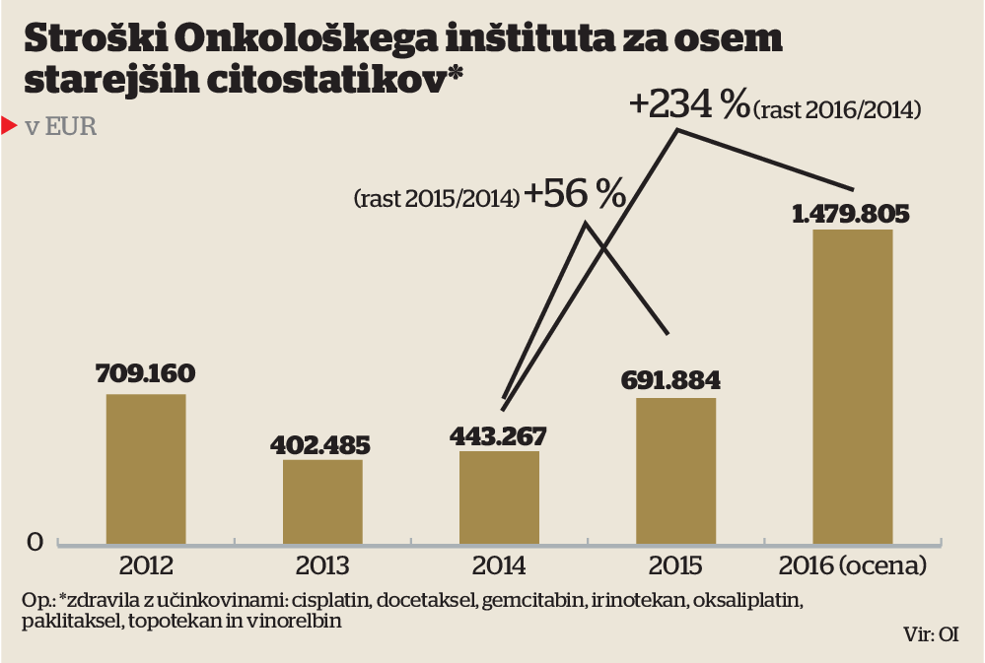
„Winner takes all“ contract award system (cont.)
Recent article in prime Slovenian business magazine (Finance)
Recent newspaper article analyzing enormous increase of price of several generic cytostatic:
Paklitaksel: 838% price increase since 2014
Irinotekan :796 % price increase since 2014
…
causing +234% of increase of expenses for cytostatic
Current national hospital tender requirements:
„Every candidate needs to offer at least 2 medicines of the same generic name, when available, at the same price“

Slide 10
„Winner takes all“ contract award system (cont.)
Best practice – Vaccine tenders in Canada:
Multiple winner tender introduced after industry association openly discussed potential implications of winner takes all tender on manufacturing and supply capabilities and competition.

Slide 11
Tender award criteria: Best price or MEAT?
BEST price criteria: only justified when only perfect substitutes are available on the market and none of the candidates can offer additional value to contracting authority.
MEAT criteria should be used in all other cases. Contracting authority must be able to identify and fully understand total benefit particular medicine or vaccine is bringing to society, beyond direct impact on their budget only (e.g. avoided hospitalization, less/ none complications in treatment, less absences due to sick leave…)

Slide 12
Tender award criteria: Best price or MEAT? Example: HPV vaccine tender in UK
UK: several groups of very detailed tender criteria
Clinical and cost effectiveness analyses
Protection against cervical cancer (97 points)
Protection against non cervical cancers (45 points)
Protection against genital warts (37 points)
Other clinical benefit (15 points)
Administration cost (1 point per £1)
Programme risk (calculation)
Risk mitigation cost 1 point per £1 annual cost)
Vaccine price (subtract offered price per dose)
Technical and commercial criteria
Storage cost (1 point per £1)
Shelf life on delivery (0,5 points for 30 months RSL
Storage flexibility (0,25 points for 12h stability)
Conditions of contract (0-2 points)

Slide 13
Questions?
Thank you very much for your attention!

