Slide 1

Contract Management
Experience of the Netherlands
Marcel Stuijts MSc CPD
The Netherlands

Slide 2

Content
Introduction
Public procurement landscape of the Netherlands
Process
Acceptation
Goals
Why Contract management
Stakeholders
Vision
Contract management: how to start
Supplier relationship & categorisation
Activities and tasks

Slide 3

Personal introduction
Marcel Stuijts MSc CPD
Marcel Stuijts, currently Chief Executive Officer Bizob
  CPO of the year: Dutch Sourcing Award 2014
  Doctor student University of South Wales: Collaboration in Public Procurement
  member of the board of NEVI Public (Netherlands Association of Procurement),
  strategic advisor to the board of the Ministry of Economic Affairs regarding the developing of the National Tender Law and the development of the professionalism of the procurement policy for the municipalities in the Netherlands. (member of the expert team and supervisory committee).
  Co-authors of the Guideline Proportionality. Because of the success of this guideline (policy) it has been integrated in the National Procurement Law.
Previous experience:
  Senior Consultant G2G Croatian & Slovenia 2006-2011
    Professionalisation of the public procurement function
  Chief Executive Officer SIW, organisation for joint procurement
  Interim (Procurement) manager several public organisations
  Procurement manager Massive lighting
  Part-time teacher Economics

Slide 4
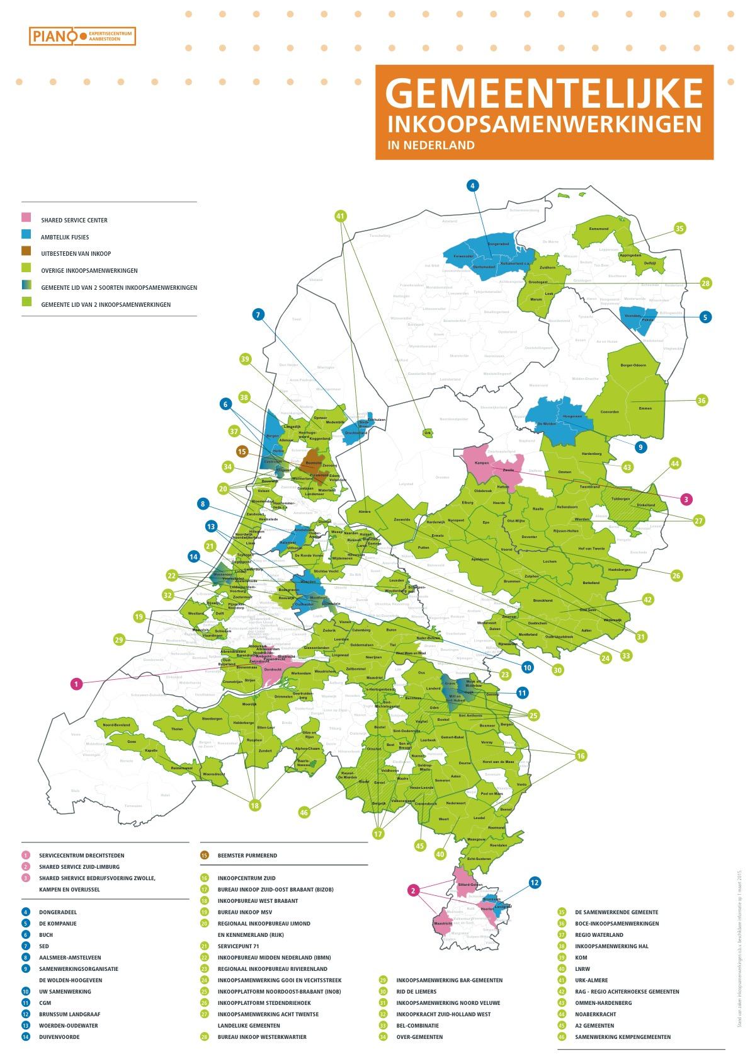
Public procurement landscape of the Netherlands

Slide 5
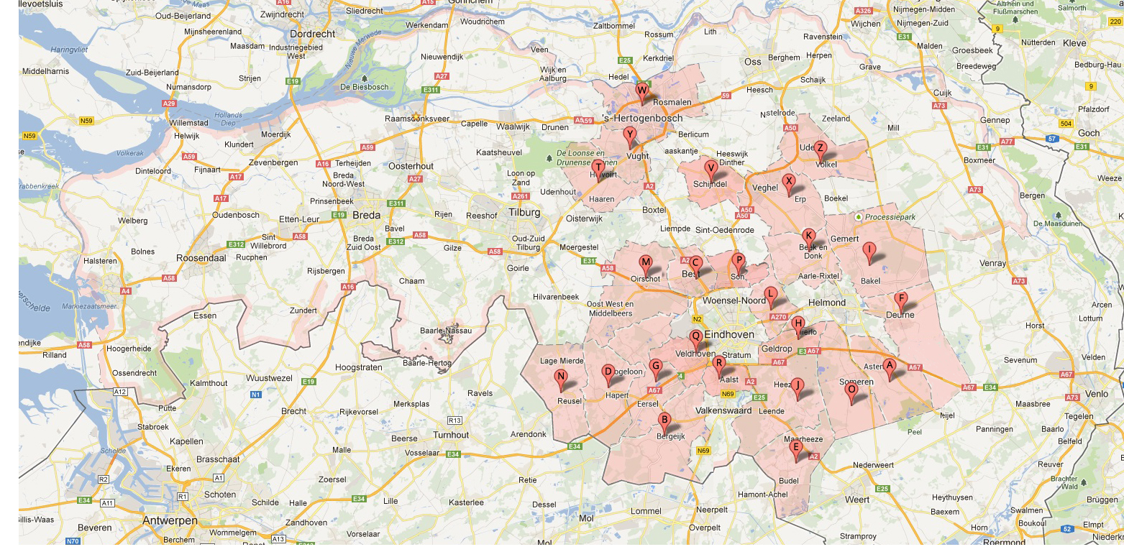
City Regions
Bizob work area
Notes:
5

Slide 6
The situation in the Netherlands
The Netherlands:
- 16,8 million inhabitants
- 400 municipalities
The Province of Noord-Brabant
67 municipalities
Region procurement cooperation’s
- West-Brabant: 24 municipalities
- South-East Brabant: 23 municipalities

Slide 7
What is Bizob?
An organisation:
for (joint) procurement and tender projects for the municipalities
e.g. for infra-structure works, goods and services;
which advises municipalities on Public, Private Cooperation cases
with suppliers and potential partners;
which advises municipalities on cases about out-or insourcing of
activities;
which analyses the product development on the market for the
municipalities.

Slide 8
Process of Contract management, administration and suppliers management
Where does it fits in the procurement process?
TACTICAL PROCUREMENT
OPERATIONAL PROCUREMENT
DEMANDS LOCAL AUTOHORITIES
SUPPLIERS
specification
selecting
contracting
bestellen
bewaken
nazorg
Sourcing
Contract administration & management
Contractinitiation
contracting
contractexecutie
contract evaluation
CONTRACTADMINISTRATION
CONTRACTMANAGEMENT
SUPPLIERSMANAGEMENT
Evaluation, improving, locking
Bron: Bizob
www.bizob.nl
8
Notes:
Working in the initial steps not operational (first 3 steps op the purchase process)
Specification
Selecting
Contracting

Slide 9
What is a successful project?
Q x A =E
The effect of a change project (E) is the result of the Quality of the change (Q) multiply the acceptation of the organisation (A)

Slide 10

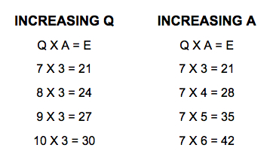
The influence of Q and A
Q x A =E
An often made mistake is: too much focuses on the What and few on How

Slide 11
Contract Management (Sociaal Domein) - Goals
Main goals
Result items
Contract administration
Comply obligations
Relation management
Performance management
Monitoring/improving of quality of service
Monitoring continuity of service
Advising stakeholders
Preventing fraud
Cost reducing

Slide 12
Why contact management?
Accountability & Budget control
No information about suppliers who are delivering
Reliable, up to date and full contract information
No control of performances
Long term
Short term
Threats
Opportunity's

Slide 13
Questions for your organisation??
Do we have control of our budgets?
Is de waiting list monitored and up to date?
Do we have an IT system for contract management?
How is contract management linked with the cooperate procurement policy?
…

Slide 14

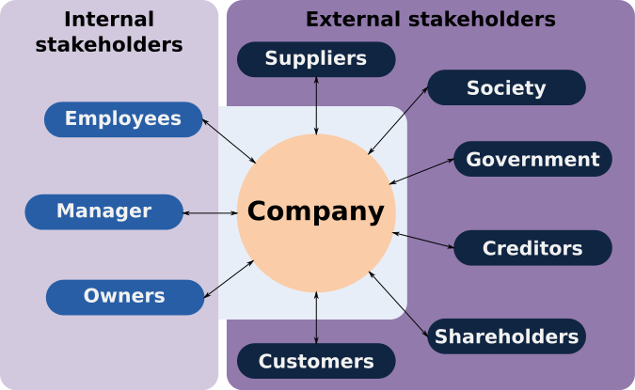
Stakeholderanalyse 1
Stakeholders are important for the success of the implementation of Contract management
Who are our stakeholders?
How do they feel about this project?
How much support do we need from them?
How do we get this support?

Slide 15
Stakeholderanalyse 2
What is the influence of these stakeholders for us project?
No. | Stakeholder | Power | Legitimacy | Urgency
1 | Citizens | No | Yes | No
2 | Accountants | No | Yes | No
3 | Politics | Yes | Yes | Yes
4 | Management | ? | ? | ?
5
6
7

Slide 16
Vision about contract management
How will our key stakeholders find out that implementation from contract management has been completed with good results?
  Our citizens will notice that …
  Our suppliers will notice that…
  The politics will notice that…
  The business operations will be run more smoothly because…

Slide 17
Suppliers analyse
Contract management: How to start

Slide 18
The influence/importance of suppliers
Not all suppliers have an equal influence on the operations of the policy of the local authority
Not all suppliers request equal attention of the local authority
Not all suppliers are equally stable.

Slide 19
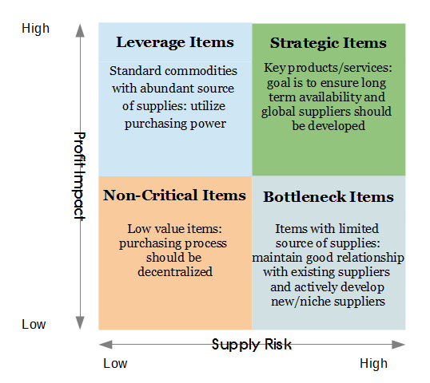
Supplier categorisation
Often incorrectly the Kraljic matrix will be applied
In this matrix the estimated expenditure is measured against the procurement risk
The goal of this matrix is to determine the procurement
In the case of contract management this procurement strategies are established and the awarded supplier has been contracted

Slide 20

Supplier relationship
As the purpose of Contract Management (besides contract
administration) is mainly performance and compliance, there are
relationships to be built and managed that do justice to the importance of the supplier for the municipality.

Slide 21
Supplier categorisation
A more suitable method of supplier classification than for sales only, can be with these criteria:
Contracted amount
Number of clients importance / citizen
Local importance / political impact
Dependency / supply and business risks
(Public) Subsidy
Innovation potential

Slide 22
Supplier categorisation - Example
Example
Criteria |  | Value | Weighing factor | Score | Result | Per cent
Turnover (EUR) | >750k | 4 | 25% | 1 | 0.25 | 6%
 | 350-750k | 3
 | 50-350k | 2
 | <50k | 1
Number of clients | >1000 | 4 | 20% | 1 | 0.2 | 5%
 | 100-1000 | 3
 | 25-100 | 2
 | <25 | 1
Politic importance | H | 4 | 10% | 4 | 0.4 | 10%
 | L | 0
Specialist/Monopolist | Y | 4 | 20% | 4 | 0.8 | 20%
 | N | 0
Innovative potential | H | 4 | 5% | 4 | 0.2 | 5%
 | L | 0
Subsidy | H | 4 | 20% | 4 | 0.8 | 20%
 | L | 0
 |  |  | Total | 18 | 2.65 | 66%

Slide 23
How rigorously managed contracts must be managed?
Strategical
≤ 3 suppliers
Core
< 10 suppliers
Must be managed (but no more than that)
< 5 % of the suppliers
Transnationaal
The remainder
Whats left

Slide 24
Activities and tasks
Contract management

Slide 25

Core activities
1. Contract administration
1 | Contracts archiving (paper and digital)
2 | Signalling and alert
3 | Reporting
4 | Keeping up-to-date of relevant contract data
5 | Unlocking contract information to the organisation
2. Relation management
1 | Establishing how to manage and governance
2 | Stakeholder management (in/ex)
3 | Faciliting top meeting between municipality and supplier
4 | Facilitating / chair negotiation meetings
5 | Antenna function market
6 | In/out phasing of suppliers
3. Performance management
1 | Compliance / enforcement of agreements
2 | Determine and measure of performance indicators and KPI’s
3 | Measure, adjust and improve of performance
4 | Conflict management
5 | Risk management
6 | Boost of innovation
Not:
Control of tender requests (= sourcing)
Chasing missing documents (= sourcing)
Contacts with citizens (= de line)
Solve of individual invoice problems (= administration)
Solve of individual service problems (= specialist)
Ever:
Complete knowledge of the contract
Rapport of all CM activities
Advise sourcing about market and supplier

Slide 26

Tasks
The tasks of the contract manager should be established on the basis of the objectives and supplier selection of the awarded contracts:
  Some tasks, such as contract administration, will be the same for each CM
  Depending on the supplier classification of the relationship and performance management will be interpreted differently.

Slide 27

References
Boes, H., Doree, A., (2008), ‘Public Procurement of Local authorities in the Netherlands: A case of breaking tradition for a more strategic
approach?!’, 24th Annual ARCOM Conference: Cardiff, UK, pp. 477 – 486.
Caldwell, N. and M. Howard (2014). "Contracting for complex performance in markets of few buyers and sellers The case of military procurement.“
International Journal of Operations & Production Management 34(2): 270-294.
Gelderman, Van Weele, (2005), ‘Purchasing Portfolio Models: A Critique and Update’, The Journal of Supply Chain Management, Vol. 41, No. 3, pp.
19 – 28.
Gelderman, C.J., Ghijsen P.W.Th, Brugman M.J, (2006), ‘Public procurement and EU tendering directive-explaining non-complience’, International
Journal of Public Sector Management, Volume: 19 Issue: 7, [online], available:
http://www.ou.nl/Docs/Faculteiten/MW/MW%20Working%20Papers/GR%200604%20Gelderman%20Ghijsen%20and%20Brugman%202006_.pdf
Hill, T. (2005). "Operations management”.
Lam, T. and K. Gale (2014). "Highway maintenance: impact of framework agreements on contractor performance." Engineering, Construction and
Architectural Management 21(3): 336-347.
Lysons, K. Purchasing and Supply Chain Management’. Prentice Hall,fifth ed, 2006
Shafahi, A. and A. Haghani (2014). "Modeling contractors' project selection and markup decisions influenced by eminence." International Journal
of Project Management 32(8): 1481-1493.

Slide 28


