Slide 1
Workshop on Obtaining Value in Public Procurement
Klub Poslanika
Belgrade, 2 June 2016
International Experience on Ways to Evaluate Tenders and Make the Source Selection Decision
Natascha Graff
Procurement Analyst
European Central Bank

Slide 2
Procurement Goals
?

Slide 3
Procurement Goals
Obtain value for money
Achieve fair, objective comparison of bids
Implement horizontal policies (environmental or social goals)
Identify new suppliers, new products or methods
Foster innovation
Comply with law, ensure accountability
…

Slide 4
Procurement Goals EU Directive
Support Europe 2020 strategy for smart, sustainable and inclusive growth
Ensure most efficient use of public funds
  increase efficiency of public spending
  facilitate participation of SMEs
  support common societal goals
Notes:
No incentive to externalise or privatise or liberalise services performed by public services or considered of general public interest (post)
No prejudice to freedom of MS to define characteristics of services incl. quality with view to pursue their public objectives

Slide 5
Condition
Compliance with Procurement Law, Rules and Principles (transparency, non-discrimination, equal treatment, proportionality)
EU legal Framework: WTO - GPA
EU Treaty
EU Directives, Case Law
National Laws
=> Evaluation on basis of published criteria and process (no flexibility!) thus necessity to carefully choose the selection and award criteria and the process during the preparation phase!
Notes:
General Agreement on Tariffs and Trade (GATT) 1948 (goods) -> World Trade Organisation (WTO) Urugay Round 1995 (GATT + GATS (services) + TRIPS + TRIMS (trade policy review mechanism) + Dispute settlement understanding (DSU)) -> Government procurement agreement (GAP) plurilateral/only those who signed
GPA members: Armenia, Canada, EU, Hong Kong, Iceland, Isreal, Japan, Rep. Of Corea, Liechtenstein, Montenegro, New Zealand, Norway, Singapore, Switzerland, Taipei, US
Serbia:
- negotating WTO access, bilateral agreement with EU Stabilisation and Association Agreement (SAA) 2008
- Official candidate EU accession 2012
- Necessity to align procurement law with EU acquis

Slide 6
Evaluation steps
Formal requirements
Exclusion criteria
Selection criteria
Minimum requirements
Award criteria
  Technical
  Financial
EU procurement: no particular order
Notes:
Can be performed by different persons / boards

Slide 7
Formal requirements
Formal requirements check at opening:
  Timely submission
  Confidentiality of bids (unopened)
  Completeness
  Signatures
  Language
Notes:
World Bank: Language: English, French, Spanish + Borrower‘s country language
Sealing: two envelopes (technical and financial) makes sense when financial bis is opened at later stage (World Bank)
No matter whether paper or e-submission

Slide 8
Exclusion criteria
Eligibility is assessed on basis of fixed criteria required by law and rules, no discretion to insert new criteria:
Nationality/country of registration (multi-/bi-national trade agreements, e.g. GPA)
Tenderer is convicted by final judgement for crimes listed in regulation
Tenderer is in breach of its obligation relating to payment of taxes or social contributions
Notes:
World Bank = exhaustive definition of fraud and corruption in guidelines
Conviction: participation in criminal organisation, corruption, fraud, terrorist offences, money laundring, terrorist financing, child labour
Also if person convicted is member of administrative, management or supervisory body

Slide 9
Exclusion criteria
Optional exclusion grounds in EU procurement.
Tenderer :
is bankrupt
is guilty of grave professional misconduct
has distorted competition
is in situation of conflict of interest
has shown significant deficiencies in previous contract
is guilty of serious misrepresentation in supplying information
has undertaken to unduly influence the procurement

Slide 10
Selection criteria
Qualification criteria
  Experience and past performance
  Capability with respect to personnel, equipment, facilities
  Financial position (turnover, financial ratios)
  May not be disproportionate to contract
  In open procedures: pass threshold
  In restricted procedures: evaluation
Notes:
World Bank: idem
EU: - yearly turnover max. twice contract value
If ratios, formula must be published
per lot
European Single Procurement Document, self-declaration, supporting documents in national procurement databases, EU wide consultation

Slide 11
Minimum (mandatory) requirements
Commercial aspects
  Agreement to terms & conditions, incl. payment terms
  Insurance
Technical aspects
  Minimum technical requirements
Financial aspects
  Price validity period
  Maximum price or cost
  Non-compliance leads to exclusion if announced in the tender documents

Slide 12
Award criteria
Concept of Most Economically Advantageous Tender:
Lowest price or cost
  Option: factors other than price expressed in monetary terms, e.g. Lifecycle costing
Best price-quality ratio
  Expressed as maximum achievable points
  (example: technical: 90 points, financial: 60 points), OR
  Expressed as percentage
  (Example: technical 60%, financial 40%), OR
  Expressed as ratio
  (Example: technical/financial: 3/2)
Quality only (price is fixed)
Notes:
EU Lifecycle costing: all costs (purchase, energy consumption, maintenance costs, end oof life costs + costs imputed to environmental externalities, provided monetary value can be determined and verified, eg. Emission of greenhouse gases or other pollutant emmissions

Slide 13
Technical award criteria
Quality:
  Technical merit
  Aesthetic characteristics
  Functional characteristics
  Accessibility
  Design for all users
  Social/environmental characteristics
  Trading
Organisation, qualification and experience of staff
After sale service and technical assistance,
delivery conditions
Link to subject-matter of contract!
Notes:
Past experience / reference contracts not allowed under EU procurement
Criteria and weightings must be published

Slide 14
Horizontal policies
Preference points: Buy American Act, South African Preferential Procurement Policy Framework Act, World Bank Guidelines
EU: social/environmental aspects can be included into selection criteria, minimum requirements and/or award criteria
Notes:
Preference points: World Bank = preference amount of up to 15% of CIP (price of destination price) added to products not manufactured in country of borrower, works up to 7.5%, consultants = shortlist of 6 firms with wide geographic spread at least one from a developing country
Selection criteria: past contracts in ecological service / goods e.g. using methods which are environment friendly, ISO standards
Minimum requirements: service / goods must include environmental features, e.g. ecological fleet
Award criteria: more points to services / goods with environmental features

Slide 15
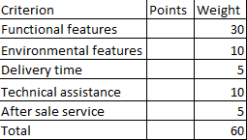
Points – technical evaluation
% of weight
100% offer exceeds requirements
75% offer fully matches requirements
50% offer largely matches requirements
25% offer shows significant deficiencies
Scores out of 5: Scores out of 10:
5: offer exceeds requirements 10: offer largely exceeds requirements
4: offer fully matches requirements 9: offer exceeds some requirements
3: offer largely matches requirements 8: offer matches requirements
2: offer shows significant deficiencies 7: offer shows small deficiencies with minor
which can be rectified impact
1: offer shows significant deficiencies …
which cannot be rectified
Evaluation committee members can score jointly or individually
Notes:
Case law interpretation: Scoring system must only be published if influences way tenderers compile offers (would they have placed different offers if they had known about the scoring system?) e.g. non linear systems

Slide 16
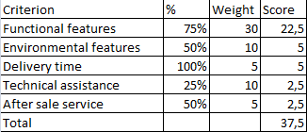
Formulae – technical evaluation
% of weight
100% offer exceeds requirements
75% offer fully matches requirements
50% offer largely matches requirements
25% offer shows significant deficiencies
Method 1:
Score = % * Weight
Possibility to request minimum pass scores
Notes:
World Bank: applied for consultants

Slide 17
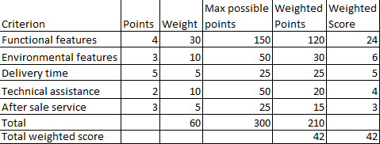
Formulae – technical evaluation
Method 2:
Weighted points = points * weight
Total weighted score = (sum of weighted points / max. possible points) * total weight
Method 3:
Weighted score = points / max points * weight
Possibility to request minimum pass scores

Slide 18
Frequent mistakes (EU system)
confusion between selection and award criteria
  Example: points for number of previous similar projects
  Example: points for total workforce
poor justification of scores
  Example: comment: „the offered service is of good quality“ (problem: no definition of „good“)
  Example: offer scores low, but the comments include only positive remarks
Notes:
Selection criteria as award criteria not allowed in EU but possibly in other systems

Slide 19
Frequent mistakes (EU system)
introduction of new award criterion during evaluation process
  Example: justification for low score includes a negative remark concerning an element that was not required in the technical specifications
  Mitigation: establish link with published requirements

Slide 20
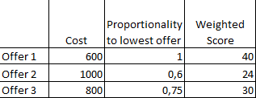
Formulae – Financial evaluation
Weight: 40
Weighted Score = lowest cost/cost * weight
  Currency: either fixed or conversion to rate fixed in advance
Notes:
Example based on total costs

Slide 21
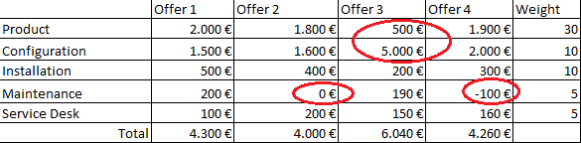
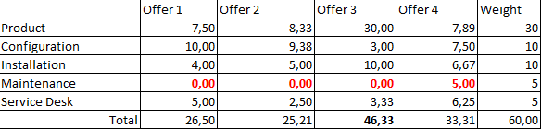
Formulae – Financial evaluation
Problems arising when evaluating with sub-weightings
Weight: 60

Slide 22
Formula for financial evaluation
Lowest price(cost) / price(cost) * weight
Criticised: • offers not assessed individually
• scores not linear
But: Other systems require fixing
a price beforehand: difficult,
what to do if offered price lower?
Notes:
Same for technical evaluation = avoid
Despite criticism, allowed as long as announced

Slide 23
Final score
Formula when weighting is 50:50:
Quality points / Price or Cost
(highest score wins)
= number of quality points purchased per monetary unit
Sum of technical score + financial score

Slide 24
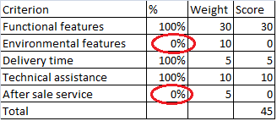
Tactical bidding
Technical bids
  Safeguard: Set minimum
  pass score thresholds
  and/or include minimum requirements
Financial bids
  Example: negative price
  Safeguard: Evaluate price scenario

Slide 25
Clarifications (EU system)
Allowed, as long as the tenderer is not given an opportunity to change his offer
Obvious clerical errors should be corrected by CA
Abnormally low offers can be rejected, but only after clarification
Notes:
When negotiation is forbidden: Grey area, in case of doubt, not take additional information into account
Abnormally low offer: case by case, comparison with other bids, -50% of average

Slide 26
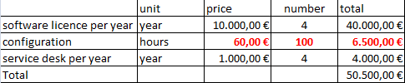
Clerical errors – financial bid
Scenario 1: the price is stated correctly in an other page of the bid
Scenario 2: the tender documents state that the hourly rates are binding
Scenario 3: the tender documents state that the total price is binding
Scenario 4: the tender documents state that incoherent offers will be excluded
Scenario 5: the tender documents do not state any of the above

Slide 27
Clerical errors – technical bid
Example: Offer states: “The service desk is operational on Saturdays and Sundays” but the tenderer wanted to write “...is not operational..”
=> If score is reduced = correction allowed in principle
Opposite: tenderer wrote: “is not operational” but meant “is operational”
=> If score is higher = correction allowed only if clear from context (e.g. references in other parts of the offer, financial offer for 24/7 service desk)

Slide 28
Ways to safeguard objectivity
Choose clear, objective and quantifiable criteria
Anonymous bids
Keep financial offer confidential/closed until evaluation of technical offer is finalised
Evaluators sign declaration of non-conflict of interest
Evaluation committee members have no hierarchical link between them

Slide 29
Obtaining best value for money
Foster competition / participation (advertisement, simplicity, transparency)
Increase quality of tender documentation
Where feasible: include demonstration into award procedure
Where sensible: include interviews into award procedure
In negotiated procedures: hold final offer dry-run
For complicated tenders: obtain external expert advice

Slide 30
Thank you!

