Slide 1
Workshop on Obtaining Value in Public Procurement Klub Poslanika Belgrade, 1 June 2016
The Challenge of Deciding What Procurement Method to Use
Natascha Graff Procurement Analyst European Central Bank

Slide 2
Available procedures in EU system
Above GPA threshold:
Open Procedure
Restricted Procedure
Competitive Procedure with Negotiation
Competitive Dialogue
Innovation Partnership
Negotiated Procedure without Prior Publication
« Light Regime Procedure » for Annex XIV services
Notes:
World Bank:
International Competitive Bidding
International Competitive Bidding with Prequalification: desirable when large or complex works, high costs for preparing bids (custm designed equipment, industrial plant, specialised services, .. ) would discourage tenderers from participation
Two-stage bidding: first unpriced bids, technical and commercial clarifications and adjustments, amended bidding documents, submission of final bids
Limited international bidding: procedure without advertisment, dirct invitation, when only limited number of suppliers, other exceptional reasons
-National competitive bidding, when procurement unlikely to attract foreign competition (small value, works scattered geographically or over time, labour intensive, available locally at price below international market)
-Shopping : price only, off-the-shelf
-Direct contracting (same as EU)
Annex 14: social and security services, hotel and restaurant, postal services

Slide 3
Open procedure
Always available, no conditions for use
EU-wide advertisement
Tender documents fully available to every interested supplier
Every supplier can submit an offer
Time limit: min. 35 days
Direct award to offer obtaining highest score
No negotiation of the offers
Notes:
Time limit is for receipt of offers
Time limit can be shortened to 15 days in case a Prior Information Notice was published min. 35 days in advance or in case of urgency
Time limit can be shortened to 30 days in case offers can be submitted electronically

Slide 4
Restricted procedure
Always available, no conditions for use
EU-wide advertisement
Every supplier can submit a request to participate
Min. time limit for application 30 days
CA selects min. 5 suppliers
Min. time limit for offers 30 days
Direct award to offer obtaining highest score
No negotiation of the offers
Notes:
Selection based on objective an non discriminatory criteria or rules which must be published in PQQ
Minimum number: any number including and above
Maximum number: binding, CA cannot go below
If fewer than min. qualify = ok
Time limit for application can be reduced to 15 days and for offers to 10 days in case of urgency
Time limit for offers can be reduced to 25 days if offers can be submitted electronically
Time limit for offers can be reduced to 10 days in case a Prior Information Notice was published

Slide 5
Open or Restricted procedure?
Few suppliers – open
Time constraints – open
Resources constraints – restricted
Many suppliers – restricted
Confidential information – restricted

Slide 6
Competitive procedure with negotiation and competitive dialogue
Use permitted only if:
The needs cannot be met without adaptation of readily available solution = customised solutions
The needs include design or innovative solutions = custom made solutions
The contracts cannot be awarded without prior negotiation because of specific circumstances related to the nature, the complexity or legal/financial makeup or risks attaching to them
Notes:
nature (example: volatile prices),
complexity (example: mixed contracts) or
legal/financial makeup (example: payment terms)
or risks attaching to them (them = nature, complexity, legal/financial makeup)

Slide 7
Competitive procedure with negotiation and competitive dialogue (ctd)
Use permitted only if:
The technical specifications cannot be established with sufficient precision with reference to a standard
Only irregular or unacceptable offers were submitted in an open or restricted procedure
Launch new procedure
Switch to negotiated procedure
Notes:
Irregular offers:
do not comply withy procurement documents,
received late,
evidence of collusion or corruption,
abnormally low
Unacceptable:
Tenderers do not have required qualifications
Price exceeds CAs published budget

Slide 8
Conduct of competitive procedure with negotiation
PQQ stage as restricted procedure (min. 3 candidates)
minimum (=mandatory) requirements & award criteria and weightings must be published
negotiation must take place with all tenderers
possibility to change technical specifications (except minimum/mandatory requirements) during the procedure
during negotiation, all types of communication are allowed: meetings, presentations, written negotiations etc.
possibility to reduce number of offers in successive stages by applying the published award criteria, provided this was advertised (!)
Notes:
negotiation must take place with all tenderers (recommendation: allocate same time and same amount of negotiation rounds)
possibility to change technical specifications (except minimum/mandatory requirements) during the procedure; recommendation: clearly identify “mandatory” and “desirable” requirements
all types of communication are allowed: meetings, presentations, written negotiations etc.; recommendation: keep written track – minutes, confirm negotiations in writing
No formal procedure required by the Directive, but principles (equal treatment, non-discrimination, transpaency, proportionality) apply

Slide 9
Conduct of competitive procedure with negotiation (ctd)
formal announcement of end of negotiations
submission of best and final offers to common deadline (!)
negotiations can only be skipped if possibility was advertised (!)
award to lowest price/cost allowed
no negotiation of the final offers (!)

Slide 10
Conduct of competitive dialogue
PQQ stage as restricted procedure (min. 3 candidates)
award criteria and weightings must be published
publication of needs and requirements
normally no technical specifications
during dialogue, one or several solutions are identified
possibility to reduce number of offers in successive stages by applying the published award criteria, provided this was advertised (!)
submission of final offers and award to best price-quality ratio

Slide 11
CPN and CD – main differences
CD: contract notice includes indicative timeframe; CPN: not required
CPN: min 30 days for submission of first offer; CD: no first offer
CPN: negotiations “to improve content of offers”; CD: “dialogue to identify and define means best suited to satisfying needs”
CPN: lowest price/cost allowed; CD: best quality-price ratio
CPN: negotiations may be skipped; CD: dialogue obligatory
CPN: common deadline for final offers; CD: not specified
CPN: no negotiations after final offers; CD: negotiations allowed to some extend
CPN: single set of tender specifications; CD: individual solutions allowed
CD: CA may specify prizes or payments to the participants in the dialogue; CPN: no mention

Slide 12
Innovation partnership
for research and innovation, solutions not available on the market, subsequent purchase
tendering phase to choose most suitable partner(s) + partnership phase to develop solutions
tendering phase:
PQQ stage as restricted procedure (min. 3 candidates)
no time limits for submission of offers
minimum requirements, award criteria and weightings must be published
negotiation of initial and subsequent offers
possibility to reduce number of offers in successive stages by applying the published award criteria, provided this was advertised (!)
submission of final offers and award to best price-quality ratio, no negotiation of final offers

Slide 13
Innovation partnership
partnership phase:
with one or several partners
structured in successive phases
setting of intermediate targets
payments in appropriate instalments
possibility to terminate partnership after each phase, provided process was advertised
purchase of the resulting supplies, services or works from partner offering best quality-price ratio
Notes:
Purchase of end solution = difference with pre-commercial procurement

Slide 14
CD and Innovation partnership: main differences
CD: contract notice includes indicative timeframe; IP: not required
IP: initial offer; CD: no initial offer
CD: “dialogue to identify and define means best suited to satisfying needs”; IP: negotiation of offers to identify most suitable partners for subsequent phase
CD: contract with single supplier for purchase of a defined solution; IP: partnership with one or more suppliers for development of a solution

Slide 15
Negotiated procedure without prior publication
may be used only in very specific cases, such as:
failed open or restricted procedure
sole supplier situation
extreme urgency
no particular process rules for contract award

Slide 16
“Light regime procedure”
may be used only for services listed in Annex 14 of Directive (health, social, legal, hotel/restaurant and security services)
Member States free to put in place national rules; must comply with principles of transparency and equal treatment

Slide 17
Choice of procedure

Slide 18
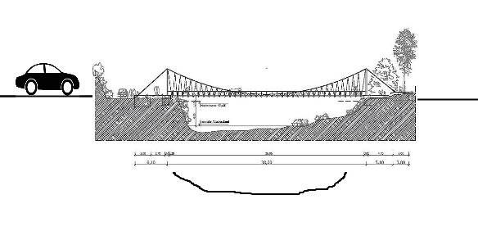
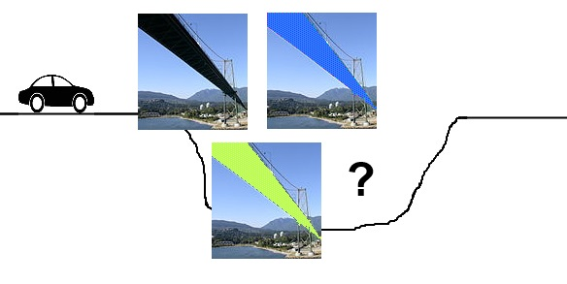
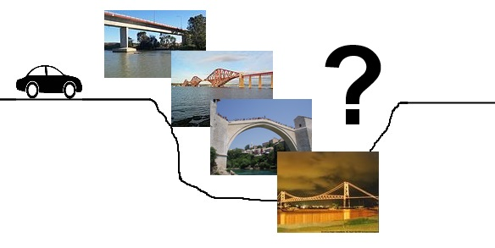
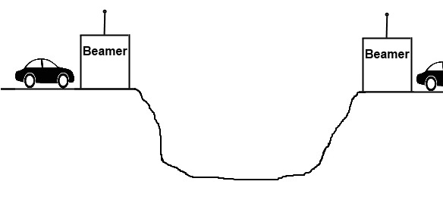
Choice of procedure
Open/restricted procedure
Comp. procedure w. negotiation
Innovation
partnership
Comp. dialogue

Slide 19
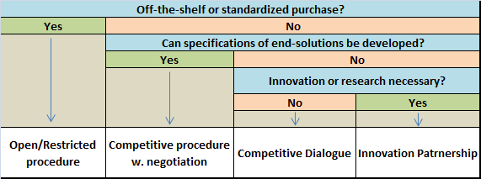
Choice of procedure

Slide 20
Thank you!

